Slide 1

Department of CSE-AI & ML (CSM)
Team:16
Regd No:20BQ1A4253 (TL), 20BQ1A4244,
20BQ1A4228, 20BQ1A4241
PROJECT REVIEW
Project Title: MediEthiCare
Develop Application to regulate health care sector from exploiting people during medical emergencies and pandemic situations
Team Members:
S. Ramya - 20BQ1A4253
P. Hema Sri - 20BQ1A4244
K. Jayanth - 20BQ1A4228
P. Priestly - 20BQ1A4241
Under Guidance of : Mr. S L V V D Sarma
(Project Guide) HoD-CSM,
Mr. . S L V V D Sarma Dr.K.Suresh Babu

Slide 2
Department of CSE-AI & ML (CSM)
PROJECT REVIEW
Literature Survey:
Problem Statements we have Reviewed:
Problem Statement1 /Description Domain1 ML / AI /DL /NLP (Methodology1)
Problem Statement2/Description Domain2 ML / AI /DL /NLP (Methodology1)
Problem Statement3 /Description Domain3 ML / AI /DL /NLP (Methodology1)
Problem Statement4/Description Domain4 ML / AI /DL /NLP (Methodology1)
Selected Problem Statement :
Selected Problem Statement Domain:
Problem Statement Selection Source / Platform: Smart India Hackthon 2022
Problem Statement Registered Organization: Defence Research and Development Organisation (DRDO), Ministry of Defence.
Problem Statement Outcome / Output/Purpouse: Application of Healthcare during Medical Emergencies

Slide 3
Department of CSE-AI & ML (CSM)
Team:16
Regd No:20BQ1A4253 (TL), 20BQ1A4244,
20BQ1A4228, 21BQ1A4241
PROJECT REVIEW
Abstract:
Accessing urgent and affordable healthcare during medical emergencies remains challenging for many patients. This impedes access to affordable and timely treatment when it is needed most. The proposed application introduces real-time price monitoring, ensuring transparent and competitive pricing for medical services and supplies. It incorporates an emergency resource allocation algorithm that fairly distributes essential medical resources based on objective criteria, preventing hoarding and ensuring equitable access. The application addresses the lack of clarity on bed availability and treatment details by offering a comprehensive guide to various hospitals. This includes precise rates and available medical facilities, empowering citizens to access affordable medical emergency services based on their preferences and the current availability.
In order to make the application more accessible and engaging for users, the application is incorporated with scheduling appointments and procurement medicines through the platform the application streamlines the process and minimizes wait times. Patients can select appointments based on their convenience, empowering, them to take greater control of their healthcare. A robust complaint redressal system allows users to complaint against any price transparency and false practices in hospital. Furthermore, the application employs blockchain technology to safeguard data integrity. Users receive clear alerts regarding any tampering with medicine prices when accessing specific medications. Advanced algorithms are utilized to recommend alternative medicines based on patient descriptions and reasons, empowering patients to make informed healthcare decisions.

Slide 4
Department of CSE-AI & ML (CSM)
Team:16
Regd No:20BQ1A4253 (TL), 20BQ1A4244,
20BQ1A4228, 20BQ1A4241
PROJECT REVIEW
Features of Proposed Application :
1, Registration and Login:
1, Doctors login as the healthcare providers, Users registration as patients, and regulatory authorities. Verification process to ensure the authenticity of healthcare providers and facilities.
2,Users, Doctors should be able to log in with their credentials.
2,Appointment Booking:
1, The Application must allow users to schedule appointments with healthcare professionals, providing real-time availability updates and reminders.
2,Ensure that appointments are available for emergencies.

Slide 5
Department of CSE-AI & ML (CSM)
Team:16
Regd No:20BQ1A4253 (TL), 20BQ1A4244,
20BQ1A4228, 20BQ1A4241
PROJECT REVIEW
3,Medicine Procurement:
1, The medicine procurement platform facilitates a seamless online ordering process for users.
2,Integration with pharmacies ensuring real-time updates on medicine availability, prices, and discounts
4, Beds &Services Availability:
1, This feature focuses on providing real-time information on bed availability and detailed medical services across various hospitals.
2, It ensures that users can access timely treatment as per their needs and the current capacity of the healthcare facilities
6, Medical Records:
1,Secure storage and retrieval of users' medical records securely with out any loss of data.
2, Integration with healthcare providers allows for continuous updates to medical records, ensuring that healthcare professionals have access to the most recent and relevant information

Slide 6
Department of CSE-AI & ML (CSM)
Team:16
Regd No:20BQ1A4253 (TL), 20BQ1A4244,
20BQ1A4228, 20BQ1A4241
PROJECT REVIEW
7, Complaint on Hospital Against Price Transparency:
1,User-friendly complaint submission process, specifically addressing concerns related to price transparency.
2,Clear and concise forms guide users through the complaint submission process, allowing them to provide details and supporting evidence.
8, Medicine Recommendation :
1, Recommends alternative medicines by evaluating the intrinsic features of medicines, such as descriptions of medicine and it’s reason.
2, Recommendation utilizes natural language processing techniques, such as ,F-IDF or advanced embeddings, to analyze medicine descriptions and provide personalized suggestions
8, Cashback offer and User Support:
1, The knowledge base and FAQs serve as self-help resources, options provide real-time, personalized support.
2, Users can select from various cashback plans, such as yearly or monthly, to best fit their preferences and usage patterns for flexible payments.

Slide 7
Department of CSE-AI & ML (CSM)
Team:16
Regd No:20BQ1A4253(TL), 20BQ1A4244,
20BQ1A4228, 20BQ1A4241
PROJECT REVIEW
Non-Functional Requirements of Project include :
1. Security
2. Availability 3. Performance 4. Usability and User Experience 5. Data Integrity
6. Compliance and Regulatory Requirements 7. Response Time and Latency

Slide 8
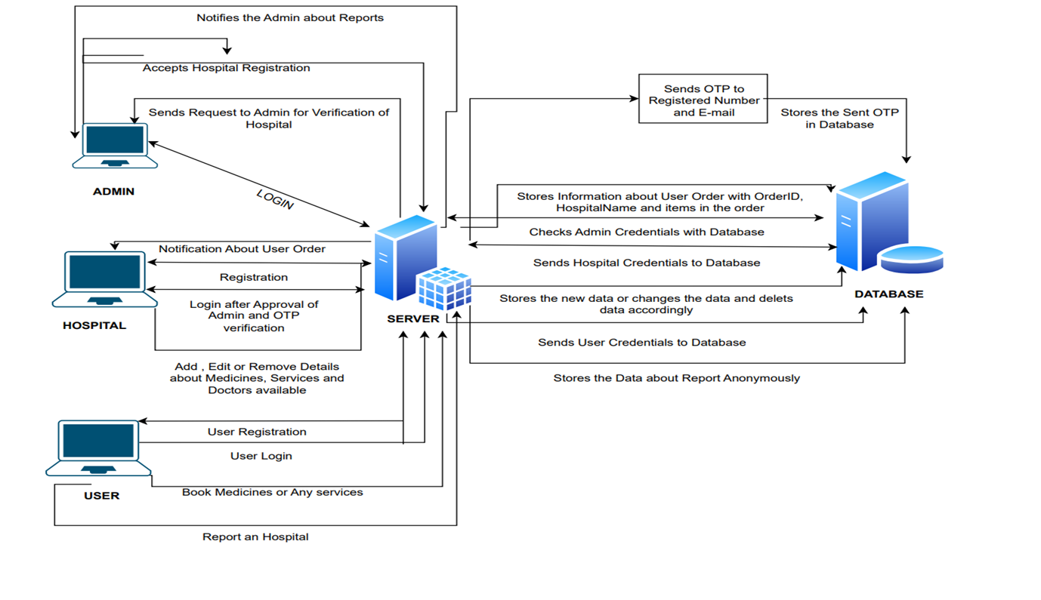
Department of CSE-AI & ML (CSM)
Team:16
Regd No:20BQ1A4253(TL), 20BQ1A4244,
20BQ1A4228, 20BQ1A4241
PROJECT REVIEW
The Architecture of the project is shown below

Slide 9
Department of CSE-AI & ML (CSM)
Team:16
Regd No:20BQ1A4253(TL), 20BQ1A4244,
20BQ1A4228, 20BQ1A4241
PROJECT REVIEW
Problem Statement Title: Develop Application to regulate health care sector from exploiting people during medical emergencies and pandemic situations
Once User logging into the application securely, users navigate through an array of features ranging from appointment booking and creating medicine buying lists to checking out available medical equipment and reviewing their medical records. This diverse set of functionalities allows users to customize their healthcare experience according to their individual needs.
Once users decide on a particular service, such as booking an appointment or managing their medicine buying list, the application dynamically presents them with a tailored list of hospitals or healthcare providers that offer the chosen service. This feature streamlines decision-making, making it easier for users to select the most suitable healthcare provider. The application aims to prioritize user satisfaction and convenience by combining security, flexibility, and personalization in the healthcare journey. The goal is to offer users a straightforward and efficient means of accessing diverse healthcare services while ensuring the confidentiality and integrity of their health information.
BlockChain Technology is used in the application to maintain security of data being stored in the database. Additionally it also helps users to not retrieving person’s data to hospitals about the complaint reised against the hospital.This helps to store the user’s information securely in the database with out being hacked.Here we Used Ethernum for security of our application and maintain data integrity

Slide 10
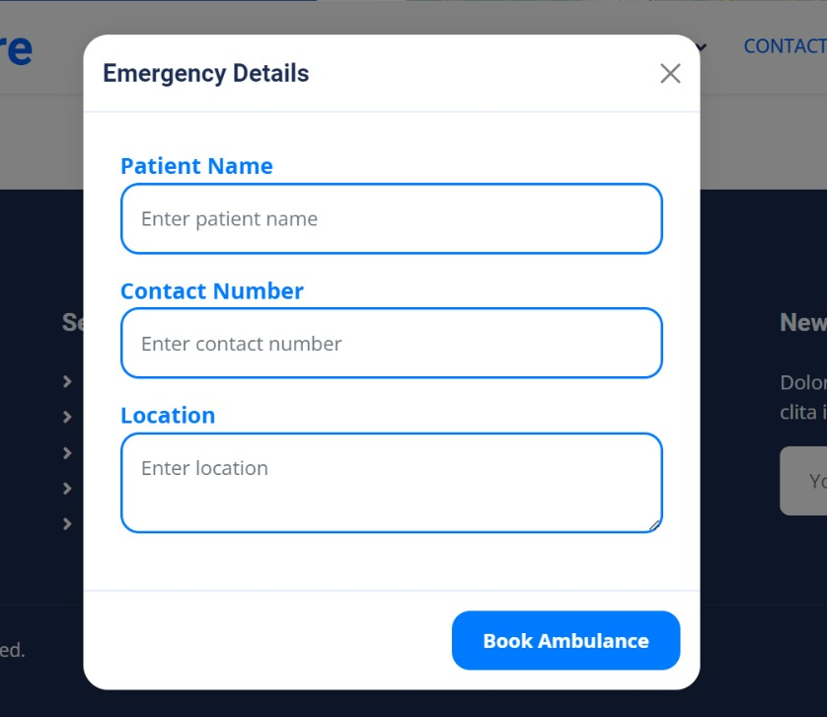
Department of CSE-AI & ML (CSM)
Team:16
Regd No:20BQ1A4253(TL), 20BQ1A4244,
20BQ1A4228, 20BQ1A4241
PROJECT REVIEW
Problem Statement Title: Develop Application to regulate health care sector from exploiting people during medical emergencies and pandemic situations
The application prioritizes user safety by incorporating an emergency
coordination feature that empowers users to swiftly and directly contact
assistance in critical situations. This immediate access to emergency
services ensures a rapid response when needed most, contributing to an
enhanced level of safety and security within the application.
The user-friendly interface seamlessly integrates this feature, allowing
users to navigate and utilize it intuitively. With real-time assistance
capabilities, the emergency coordination option serves as a proactive
measure, providing users with the assurance that they can promptly
connect with relevant contacts or emergency services in times of urgency.

Slide 11
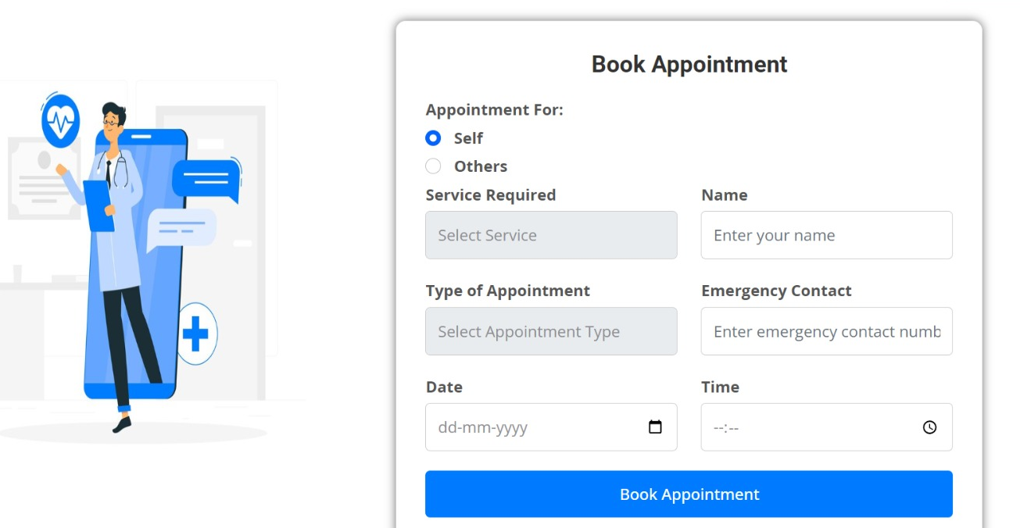
Department of CSE-AI & ML (CSM)
Team:16
Regd No:20BQ1A4253(TL), 20BQ1A4244,
20BQ1A4228, 20BQ1A4241
PROJECT REVIEW
Problem Statement Title: Develop Application to regulate health care sector from exploiting people during medical emergencies and pandemic situations
The application facilitates a streamlined appointment
booking process for patients, allowing them to reserve
appointments at their chosen hospital with specific
details such as the type of service required, preferred
date and time, and the type of appointment needed.
This efficient booking system alleviates the need for
patients to physically visit hospitals and endure waiting
times, offering a convenient alternative to manage their
healthcare. By providing essential information in
advance, patients can optimize their time, reducing
unnecessary waiting periods and ensuring a more
efficient and patient-centered experience when they
arrive for their scheduled appointments. This approach
aims to enhance overall patient satisfaction and contribute to a more effective utilization of healthcare resources.

Slide 12
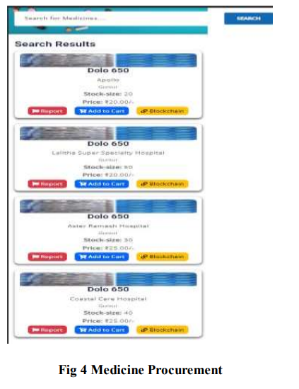
Department of CSE-AI & ML (CSM)
Team:16
Regd No:20BQ1A4253(TL), 20BQ1A4244,
20BQ1A4228, 20BQ1A4241
PROJECT REVIEW
Problem Statement Title: Develop Application to regulate health care sector from exploiting people during medical emergencies and pandemic situations
The medicine procurement feature within the application benefits the way users
obtain essential pharmaceuticals. By integrating with multiple hospitals, users can
seamlessly search for medicines and easily compare prices, promoting transparency
and empowering users to make informed decisions. Should users identify exploitative
pricing, the application offers a platform to raise complaints, effectively holding
hospitals accountable for fair pricing practices. Once users choose their preferred
options, the process of checking out medicines is streamlined through integrated
payment gateways, ensuring a seamless and secure transaction process. After hospitals
accept placed orders, customers can choose to have their purchases delivered or opt for
collection by checking the orders that has been placed with in their profile. It helps in
user to know about medicines and their availability in various hospitals.

Slide 13
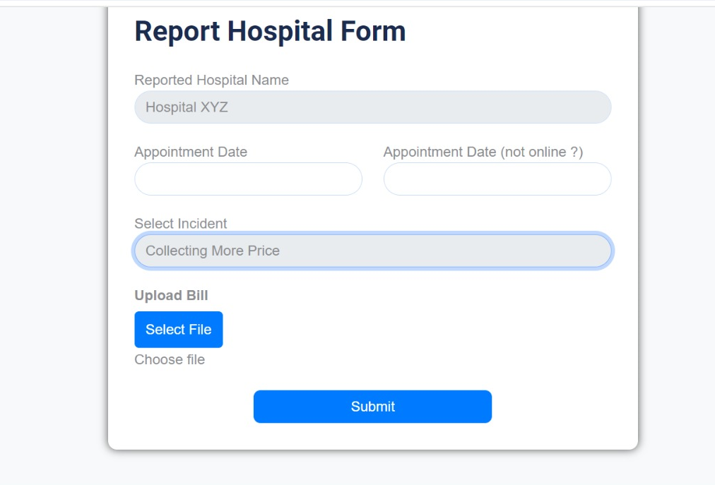
Department of CSE-AI & ML (CSM)
Team:16
Regd No:20BQ1A4253(TL), 20BQ1A4244,
20BQ1A4228, 20BQ1A4241
PROJECT REVIEW
Problem Statement Title: Develop Application to regulate health care sector from exploiting people during medical emergencies and pandemic situations
The application empowers users to report any or concerns they
may have regarding their hospital experience, including instances
of high prices or any questionable activities. This feature serves
as a crucial feedback avenue, allowing users to communicate
their observations transparently. By encouraging users to share
their feedback, the application aims to create a culture of
accountability within healthcare institutions, ensuring that
concerns are addressed promptly. This mechanism not only
provides users with a platform to express their experiences but
also reinforces the commitment to continuous improvement in
the quality and affordability of healthcare services. The
application's dedication to fostering open communication
reflects its mission to prioritize user satisfaction and enhance
the overall healthcare experience.

Slide 14
Department of CSE-AI & ML (CSM)
Team:16
Regd No:20BQ1A4253(TL), 20BQ1A4244,
20BQ1A4228, 20BQ1A4241
PROJECT REVIEW
Problem Statement Title: Develop Application to regulate health care sector from exploiting people during medical emergencies and pandemic situations
In the realm of healthcare, seeking alternative medications often requires navigating a complex landscape of options. However, advancements in Artificial Intelligence (AI) offer innovative tools like BERT, a powerful language model capable of delving deep into the world of text and unlocking valuable insights. The initial phase involves cleansing and restructuring the medicine descriptions for machine learning ingestion, followed by encoding the text into numerical representations via advanced weighting schemes such as TF-IDF to calculate relevancy.
1,Text Similarity:
This technique can be used to find similarities between different articles, research papers, or user queries related to alternative medicines. By measuring the similarity between texts, you can recommend alternative medicines based on their similarity to ones the user is already interested in or has found effective.
2,Keyword Extraction:
Keyword extraction can identify important words or phrases related to alternative medicines within text. These keywords can then be used to match user queries with relevant articles or information about alternative medicines. Keyword extraction involves identifying important words or phrases from a piece of text that best represent its content. Techniques such as TF-IDF (Term Frequency-Inverse Document Frequency) or Text Rank can be used for keyword extraction

Slide 15
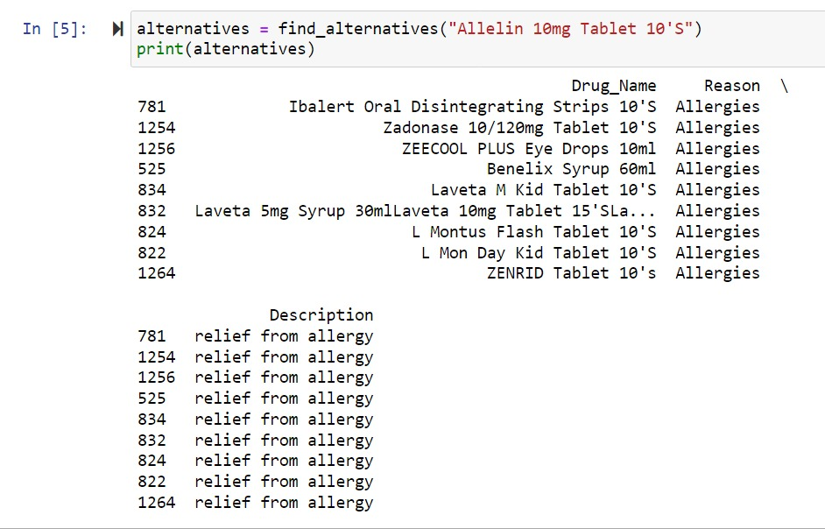
Department of CSE-AI & ML (CSM)
Team:16
Regd No:20BQ1A4253(TL), 20BQ1A4244,
20BQ1A4228, 20BQ1A4241
PROJECT REVIEW
Problem Statement Title: Develop Application to regulate health care sector from exploiting people during medical emergencies and pandemic situations

Slide 16
Department of CSE-AI & ML (CSM)
Team:16
Regd No:20BQ1A4253 (TL), 20BQ1A4244,
20BQ1A4228, 20BQ1A4241
PROJECT REVIEW
Problem Statement Title: Develop Application to regulate health care sector from exploiting people during medical emergencies and pandemic situations
Software Tools Required for the Proposed System:
Front-end Tools: 1, IDE (Integrated Development Environment): PyCharm, Visual Studio
2, Front-End Development: HTML5, CSS3, JavaScript
Back-end Tools: 3, Back-End Development: Python, Django
4, Database Management: MYSQL
Deployment Tools: Python
Technologies : NLP, BlockChain
Monitoring Tools: Monstering the model performances
Special Tools like Clouds, Micro services ,APIs, Mobile APIs.

Slide 17
Department of CSE-AI & ML (CSM)
Team:16
Regd No:20BQ1A4253 (TL), 20BQ1A4244,
20BQ1A4228, 20BQ1A4241
PROJECT REVIEW
Problem Statement Title: Develop Application to regulate health care sector from exploiting people during medical emergencies and pandemic situations
Software Tools Required for the Proposed System:
Front-end Tools: 1, IDE (Integrated Development Environment): PyCharm, Visual Studio
2, Front-End Development: HTML5, CSS3, JavaScript
Back-end Tools: 3, Back-End Development: Python, Django
4, Database Management: MYSQL
Deployment Tools: Python
Technologies : NLP, BlockChain
Monitoring Tools: Monstering the model performances
Special Tools like Clouds, Micro services ,APIs, Mobile APIs.

Slide 18
Department of CSE-AI & ML (CSM)
Team:16
Regd No:20BQ1A4253 (TL), 20BQ1A4244,
20BQ1A4228, 20BQ1A4241
PROJECT REVIEW
Problem Statement Title: Develop Application to regulate health care sector from exploiting people during medical emergencies and pandemic situations
Team members Allocated Features and Sub tasks
Team member 1 : Feature 2,7 : Sub tasks 1 , 2 , 3, 4
Team member 2 : Feature 6,8 : Sub tasks 1 , 2 , 3, 4
Team member 3 : Feature 3,5 : Sub tasks 1 , 2 , 3, 4
Team member 4 : Feature 1,4 : Sub tasks 1 , 2 , 3, 4

Slide 19
Department of CSE-AI & ML (CSM)
Team:16
Regd No:20BQ1A4253 (TL), 20BQ1A4244,
20BQ1A4228, 20BQ1A4241
PROJECT REVIEW
Problem Statement Title: Develop Application to regulate health care sector from exploiting people during medical emergencies and pandemic situations
Conclusions:
The application aims to prioritize user satisfaction and convenience by combining security, flexibility, and personalization in the healthcare journey. The goal is to offer users a straightforward and efficient means of accessing diverse healthcare services while ensuring the confidentiality and integrity of their health information. The application developed for medical emergencies, incorporating features such as appointment booking, real-time medicine availability updates, and service information, serves as a critical resource in optimizing patient care and streamlining healthcare services. It involves implementing a robust complaint system and ensuring data integrity through mechanisms to prevent tampering, the application prioritizes patient safety and satisfaction. The proposed healthcare application addresses the challenges patients face in accessing urgent and affordable care during medical emergencies
Thank you

